Slide 1

Predicting Book Ratings with Machine Learning
By Adam Jauregui

Slide 2

The Goal
The aim of this project is to allow book publishers to uncover what a book’s average recommendation rating would be based off its text description.
The project analyzes the text description of thousands of books from the book recommendation website Goodreads and decides the best machine learning model to predict book ratings.

Slide 3
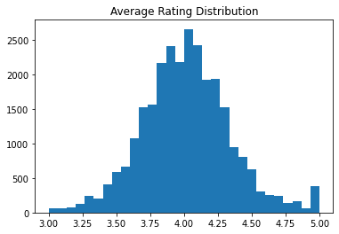
Average Ratings of Books
This is a truncated histogram of the distribution of the book’s average rating. It is approximately normally distributed.
Summary Stats
Mean | 4.01
Std | .34
Min | 0
max | 5

Slide 4
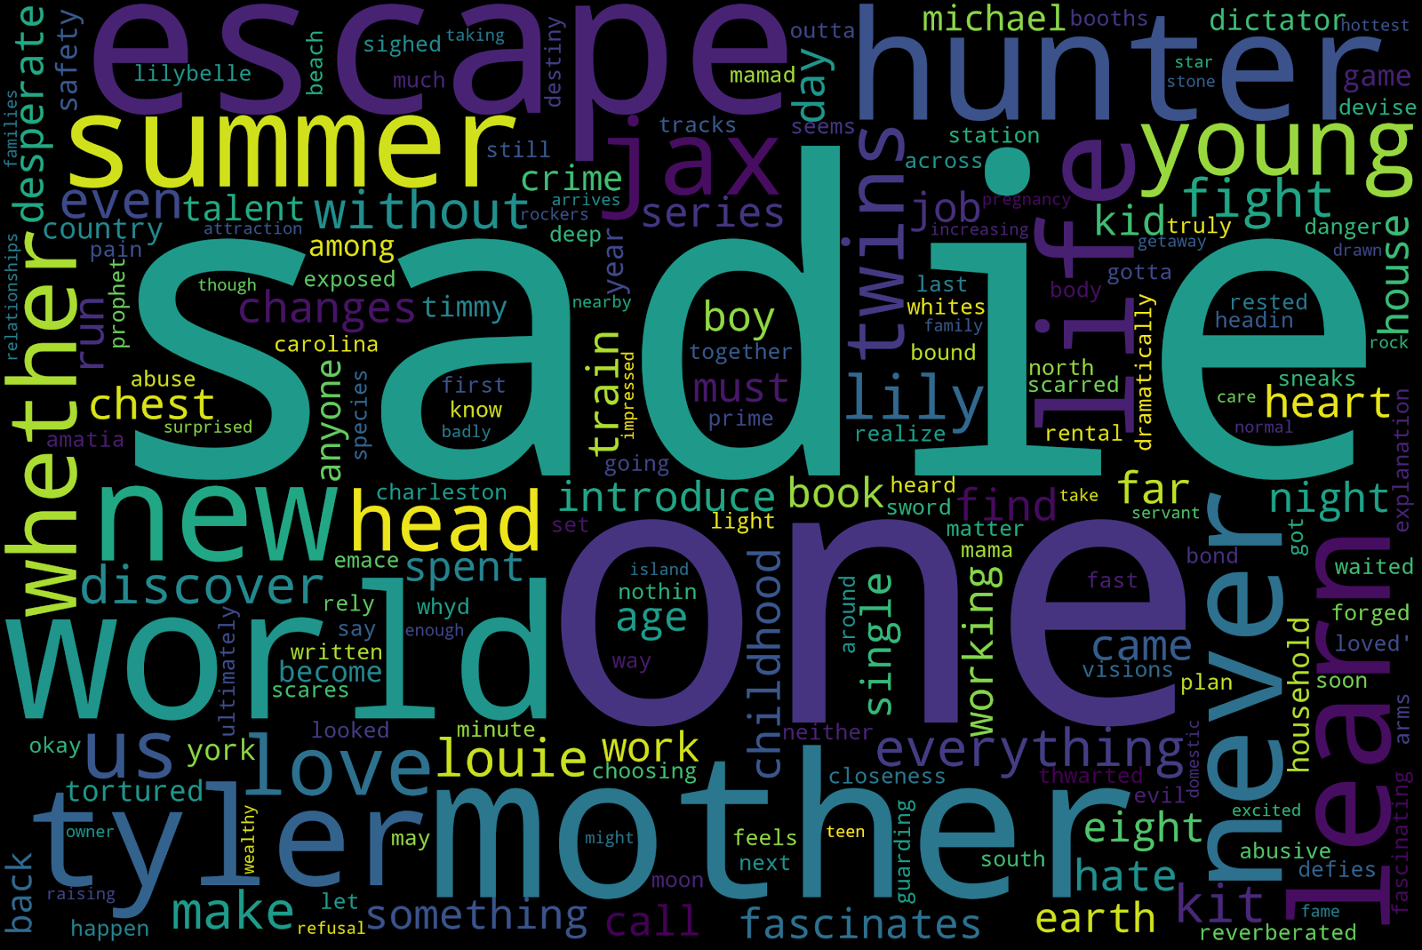
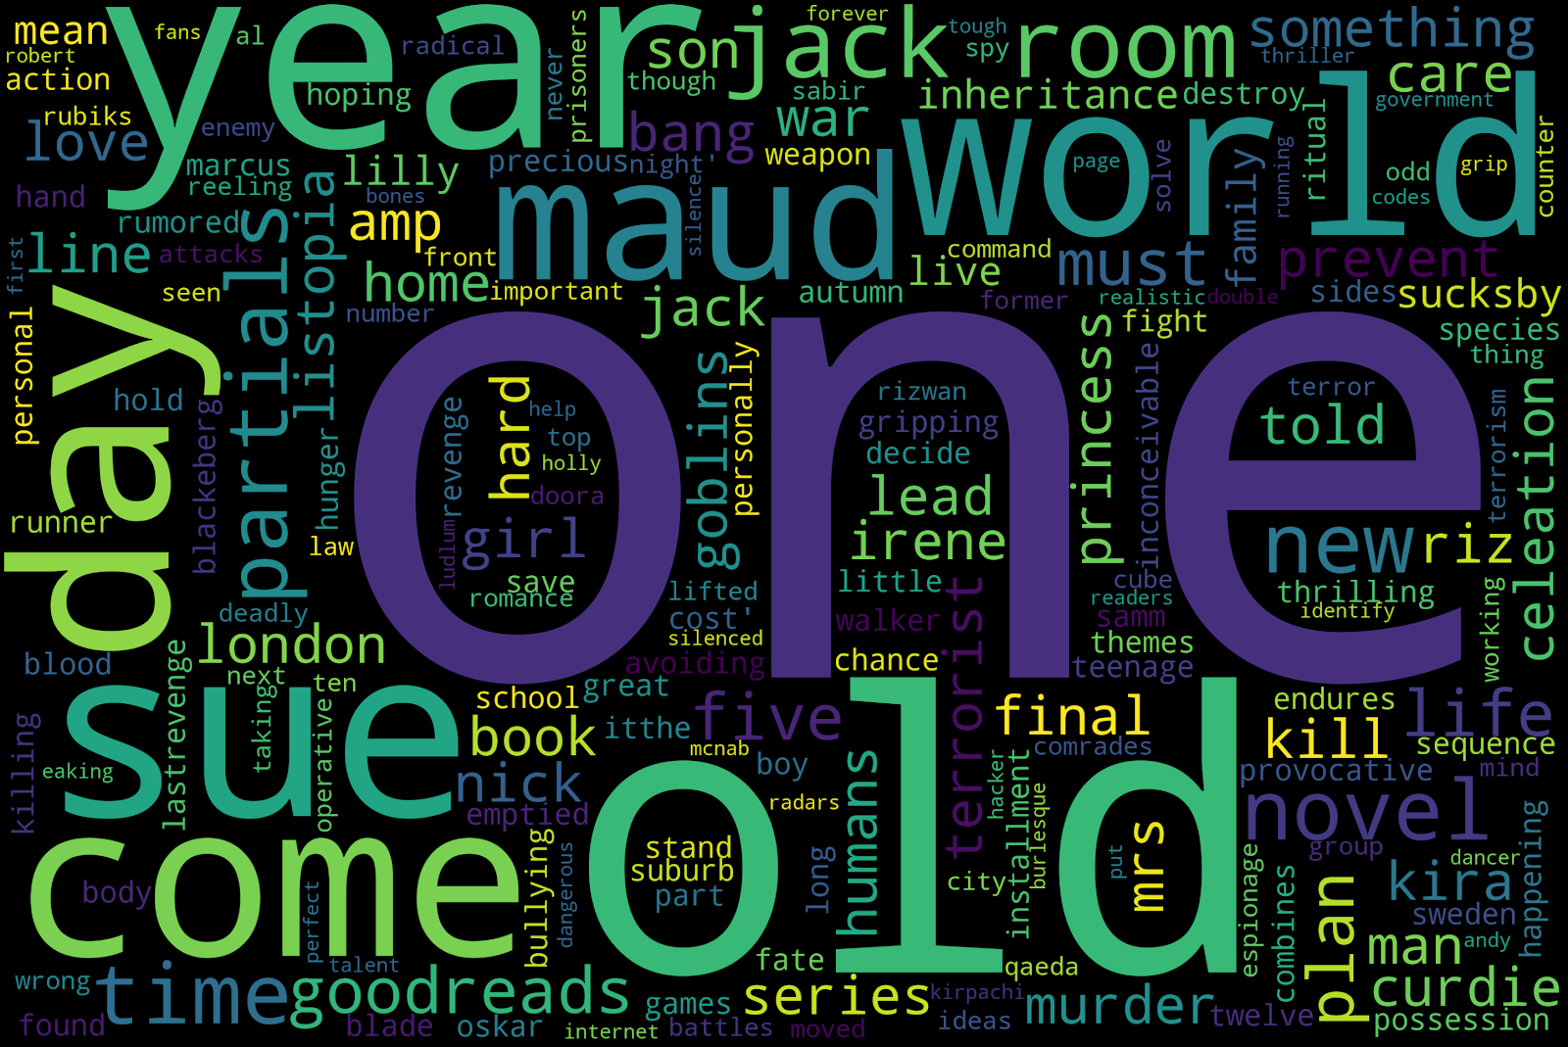
Word Cloud of Book Descriptions
To the left we have a word cloud of books’ text description with an average rating of less than 4 stars. To the right is a word could of books’ text description with an average rating of 4 stars or more. There is undoubtedly a noticeable difference between the two.
Average rating: <4 stars
Average rating: >4 stars

Slide 5
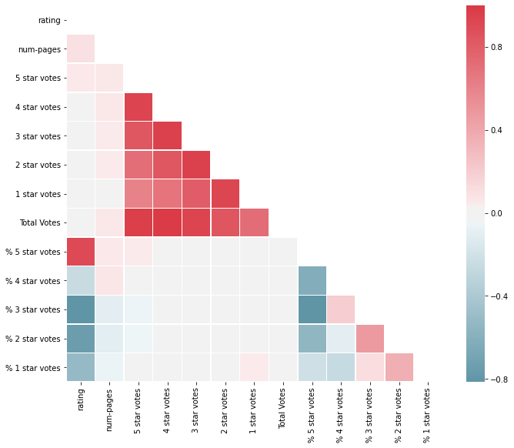
Correlation Heatmap
The darker colors are indicative of higher correlation. The variables “% 5 star votes,” “% 3 star votes,” and “% 2 star votes” are most associated with the target variable “rating.”

Slide 6
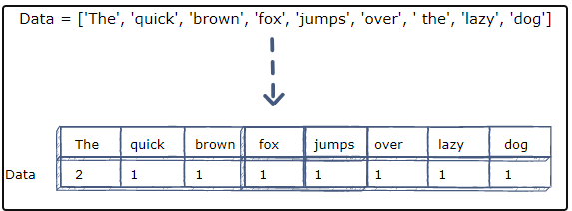
Natural Language Processing
convert the text data in the “book description” column into a vector of numbers, which is the only way that we can model text
“counts” how many times each word occurs and assigns a vector to each word. Within the cell is how many times the word happened in that text statement.

Slide 7
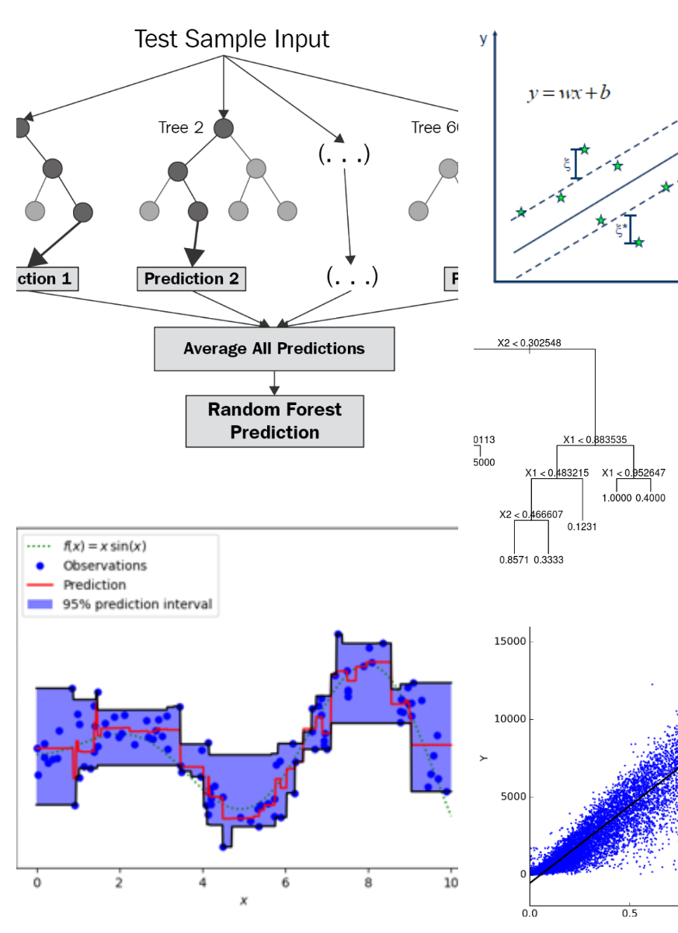
Machine Learning Models
Tested 5 different machine learning models:
Linear Regression
Support Vector Machines
Decision Trees
Random Forest
Gradient Boosting

Slide 8
ML Models’ Results
Metric used to judge each model’s results was root mean squared error (RMSE). This metric will show the average number of points each model was off in predicting a book’s average rating.
mODEL
rmse
Linear Regression
Support Vector Machine
Decision Trees
Random Forest
Gradient Boosting
0.482
0.305
0.398
0.292
0.298
A good rule of thumb is that a decent model should have an RMSE that is less than 10% of the mean (in our case, 4.01). Thus, all of our applies besides linear regression could be described at minimum as “decent.”
The top two models by RMSE were Random Forest and Gradient Boosting.

Slide 9
Tuning the Hyperparameters with Grid Search CV
We tuned the hyperparameters for our top 2 models: Random Forest and Gradient Boosting
We chose to tune the parameters “n estimators,” “max depth,” and “max features.”
Results after tuning:
Model | RMSE (tuned model) | RMSE (base model)
Random Forest | 0.29 | 0.292
Gradient Boosting | 0.293 | 0.298

Slide 10
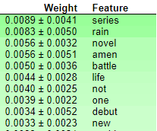
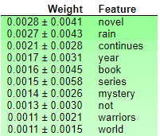
Feature Importance
Most important words according to each model.
Some words are interesting to note: “rain,” “amen,” “continues,” “not,” and “series.” However, words such as “novel” and “book” may be irrelevant to the book description. Future models might want to consider them as stop words.
Random Forest
Gradient Boosting

Slide 11

Conclusions
Recommend either Random Forest or Gradient Boosting for text regression ML models.
Random Forest was more accurate, but Gradient Boosting takes considerable less computation time. (Author notes that the former would take hours to complete, while the latter took minutes).
With the Gradient Boosting model, we can predict a book’s recommendation rating with an average deviance of .29 using just its text description. That’s impressive. Future models can fine-tune that by adding more features to the model.

